Slide 1




BUAN 5510 01- Capstone Project in Business Analytics
PATIENT CHARACTERISTICS TO PREDICT THE TYPE OF HEALTHCARE SERVICE
Optimizing Healthcare Services through Predictive Analytics
PRESENTED BY
Rabiya Fatima | Srilakshmi Mallipudi | Gautam Reddy | Barkha Sharma

Slide 2


1 | Introduction
2 | Problem Statement & Objectives
3 | Data Overview
4 | Key Findings & Insights
5 | Data Preprocessing
6 | Methodology
7 | Model Performance Evaluation
8 | Predictive Insights
9 | Use Cases and Stakeholders
10 | Recommendations
11 | Future Directions
12 | Conclusions
AGENDA
02

Slide 3
INTRODUCTION
Overview: Analyzing Patient Attributes for Healthcare Optimization.
Background Context: The increasing diversity in patient needs, along with resource limitations, emphasizes the urgency for predictive analytics
Relevance: Enhancing Healthcare Efficiency through Predictive Insights.
03

Slide 4


To predict the type of healthcare service (inpatient, outpatient, residential, emergency) patients are likely to use based on their characteristics and medical history
PROBLEM STATEMENT
Revolutionize healthcare operations by deploying predictive models for
proactive patient care and
cost-effective service delivery.
OBJECTIVES
04

Slide 5

DATA OVERVIEW
RECORDS: 255 | ATTRIBUTES: 17 | FILE SIZE: 38 KB
PARKS
RECORDS: 225 | ATTRIBUTES: 10 | FILE SIZE: 60 KB
NY HOSPITALS
COUNTY POPULATION
RECORDS: 33K | ATTRIBUTES: 18 | FILE SIZE: 6 MB
MEDIAN HOUSEHOLD INCOME
RECORDS: 27K | ATTRIBUTES: 152 |
FILE SIZE: 36.6 MB
PATIENT CHARACTERISTICS SURVEY (PCS) 2019 DATASET
RECORDS: 196K | ATTRIBUTES: 76 | FILE SIZE: 102 MB
05

Slide 6
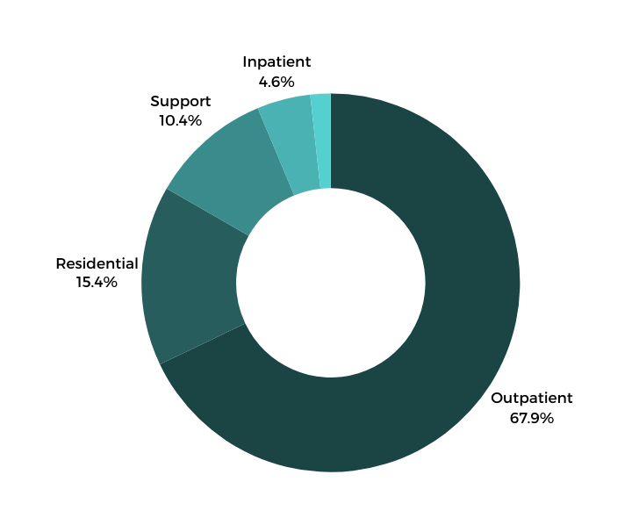

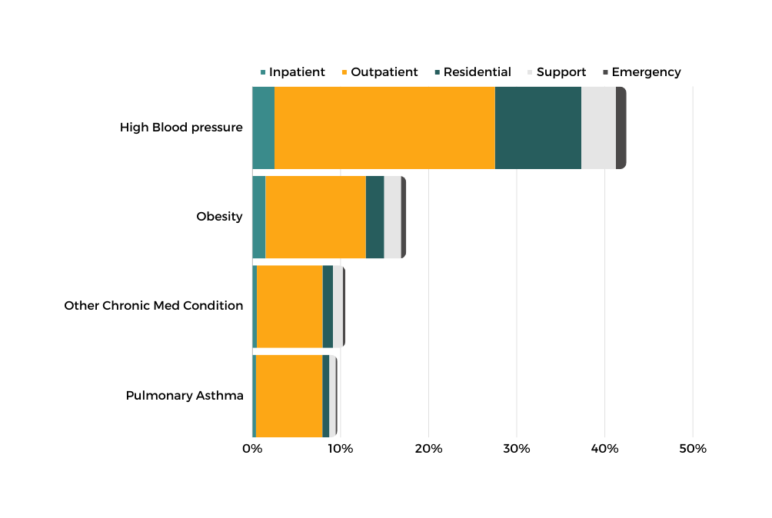
Primary Service Outpatient care
Among 196K patient records, approx. 78% of patients are adults.
Outpatient services are more commonly chosen by patients with private insurance.
Disease Trends
EDA
INSIGHTS
06

Slide 7

DATA PREPROCESSING
Back to Agenda
Data preparation included vital steps to refine and optimize the dataset for thorough analysis
Integration
Integrated external datasets using zip codes
Cleaning
Handled missing values by eliminating rows (where infrequent), assigning new labels, and replacing unknown values.
Correlation Analysis
Removed highly correlated columns
Converting nominal/ordinal values to numerical values
Mapped ordinal values to numeric scale and used one-hot encoding for nominal attributes.
07

Slide 8

METHODOLOGY
NORMALIZATION
Z-score normalization
FEATURE SELECTION
CLUSTERING
Importance values using Random Forest Classifier
K-means Clustering
PRINCIPAL COMPONENT ANALYSIS (PCA)
n = 20
OVERSAMPLING
HYPERPARAMETER TUNING
Naive Random Oversampler
RandomSearchCV
GridSearchCV
06
08
08

Slide 9
MODEL PERFORMANCE EVALUATION
Dataset Partitioning
Model Training Approach
Datasets used
Key Metric
Baseline Dataset
Oversampled Dataset
Oversampled PCA Dataset
70% for training
30 % for testing
Stratification
Trained for each dataset separately
Evaluated using test data without oversampling
Recall
Classification Model | Precision | Recall | Accuracy | Computation Time (in secs)
Random Forest | 0.98 | 0.97 | 0.97 | 215.25 secs
Decision Tree | 0.96 | 0.96 | 0.96 | 22.84 secs
Gradient Boosting | 0.78 | 0.79 | 0.79 | 2322.39 secs
09

Slide 10






PREDICTIVE
INSIGHTS
SSI Cash Assistance
Have No Insurance
Diagnosis Class: Mental Illness
Outpatient
Inpatient
Services
From New York City
Have Hospital in vicinity
Education Status
10

Slide 11


USE CASE AND STAKEHOLDER
Hospital Administrators
Resource Allocation Challenge
Hospitals struggle to efficiently allocate resources across services, resulting in operational inefficiencies and cost concerns.
Uncertain Service Demands
Determining exact service needs without predictive insights leads to staffing and resource mismatches.
11

Slide 12
R
E
C
O
M
M
E
N
D
A
T
I
O
N
S
Implement predictive models for proactive resource allocation in healthcare settings.
Foster proactive interventions using predictive insights for regional patient care plans
Lead proactive healthcare approaches via early identification and intervention for prevention strategies.
Tailor care plans based on data insights to enhance patient engagement and outcomes.
12

Slide 13


Expanded Data Integration
Cross-Regional Validation
FUTURE DIRECTIONS
Collaborative Data Collection
Specialized Model Development
Disparity Analysis
13

Slide 14


Modelling Success and Limitations
CONCLUSIONS
Successful modeling observed for non-emergency services.
Random Forest, Decision Tree and Gradient Boosting models showcased notable performance.
Challenges in Emergency Service Prediction
Accurately forecasting emergency services remains a challenge due to their unpredictable nature.
Data Validation and Model Refinement
Pioneering advancements in healthcare service prediction models.
Urging continuous refinement for enhanced real-world applicability.
14

Slide 15


Thank You
Do you have any questions?
15

